Slide 1
COVER

Slide 2
OBJECTIVE: The goal of this survey was to gain a greater understanding of the issues impacting a company’s ability to keep employees healthy, safe and productive.
METHODOLOGY:
Online Survey conducted between April 25, 2017 and May 10, 2017.

Slide 3
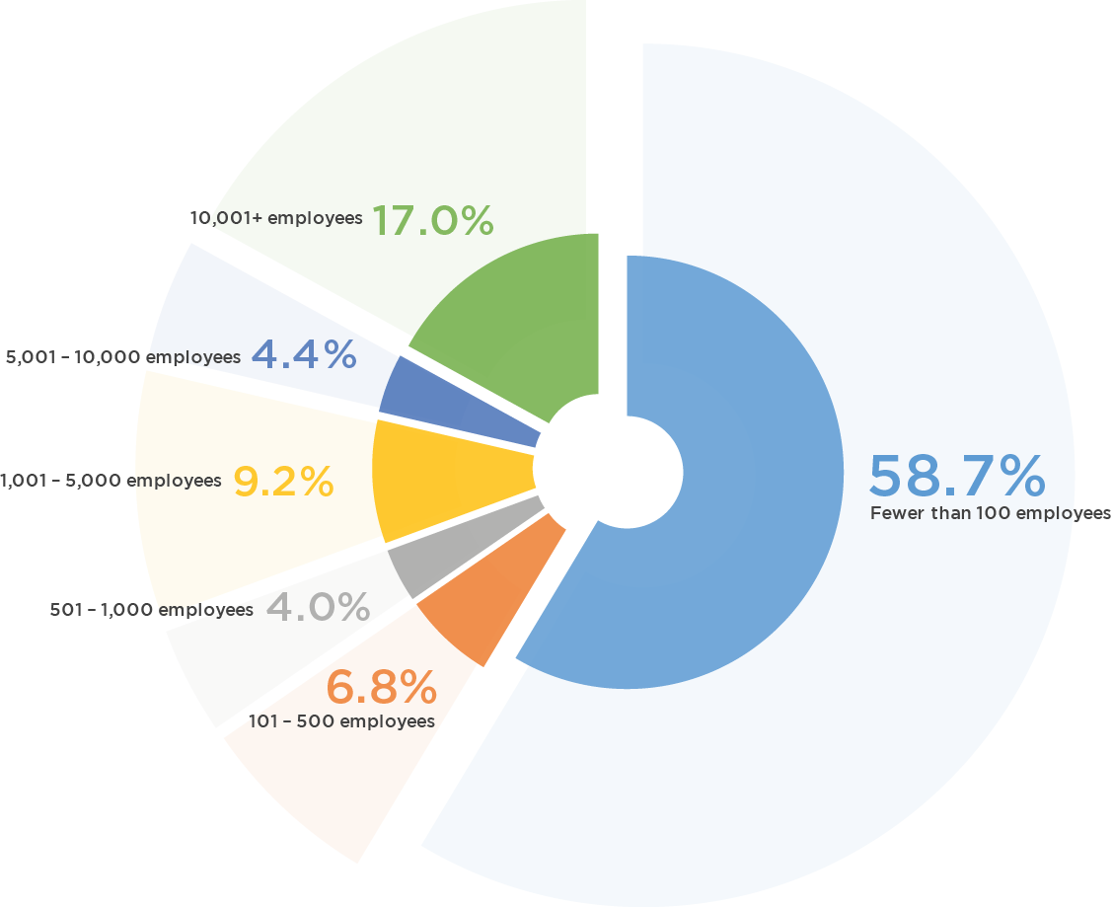
BACKGROUND
744
COMPANY SIZE BY EMPLOYEES
RESPONDENTS
TOP
3
INDUSTRIES
Professional, Scientific and Technical Services
General Manufacturing/
Chemical Manufacturing
Educational

Slide 4
KEY FINDINGS: TOP 10 THINGS WE LEARNED

Slide 5
JOB SATISFACTION
50% SATISFIED
23% VERY SATISFIED

Slide 6
JOB SECURITY
Based on current socio-economic conditions, how would you rate your job security in your organization compared to two years ago?

Slide 7
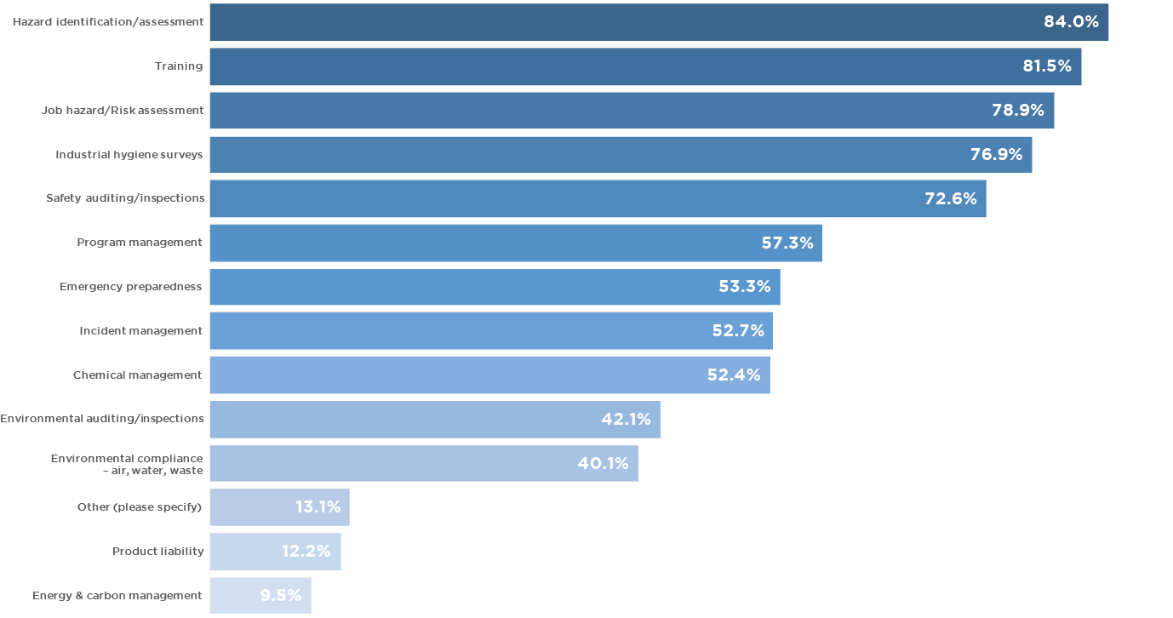
PRIMARY RESPONSIBILITIES
3
TOP
RESPONSIBILITIES
84%
Hazard Identification
Training
Job Hazard/Risk Analysis
81.5%
78.9%

Slide 8
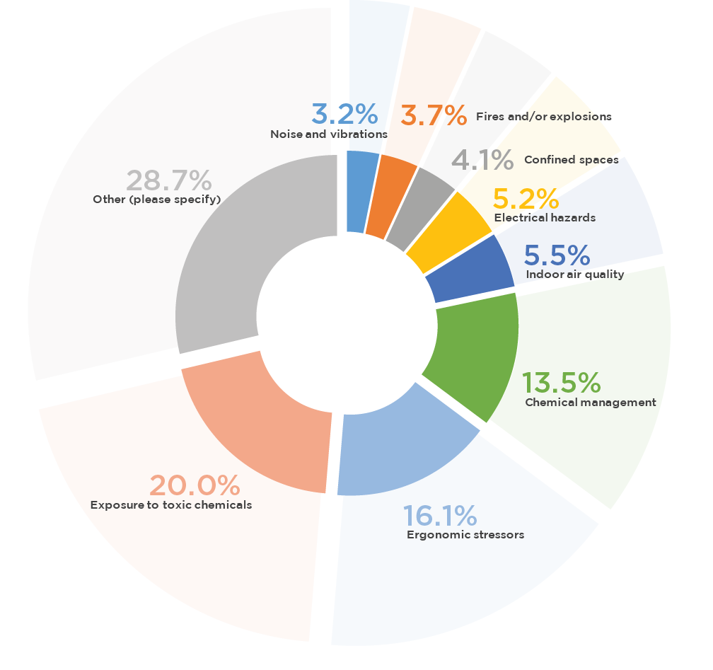
AREAS OF CONCERN
3
What do you consider to be the most important issue facing your EHS program?
TOP
20%
Exposure to toxic chemicals
Ergonomic stressors
Chemical management
16%
13.5%

Slide 9
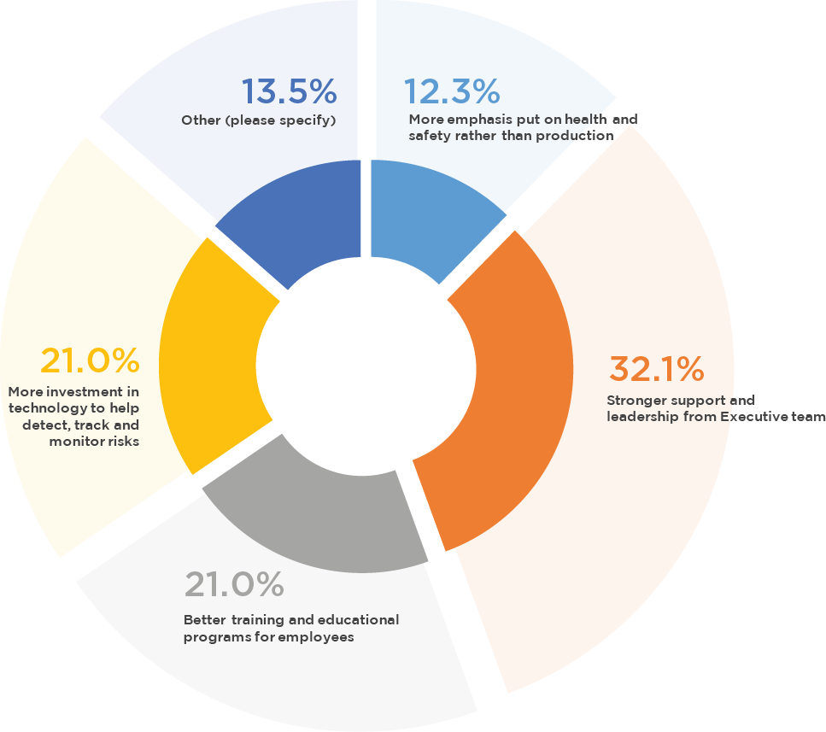
AREAS OF IMPROVEMENT
3
“In what area would you most like to see improvement in your organization/facility's EHS program?”
TOP
32%
Stronger support and leadership from executive team
Better training and educational programs for employees
More investment in technology to help detect risks
21%
21%

Slide 10
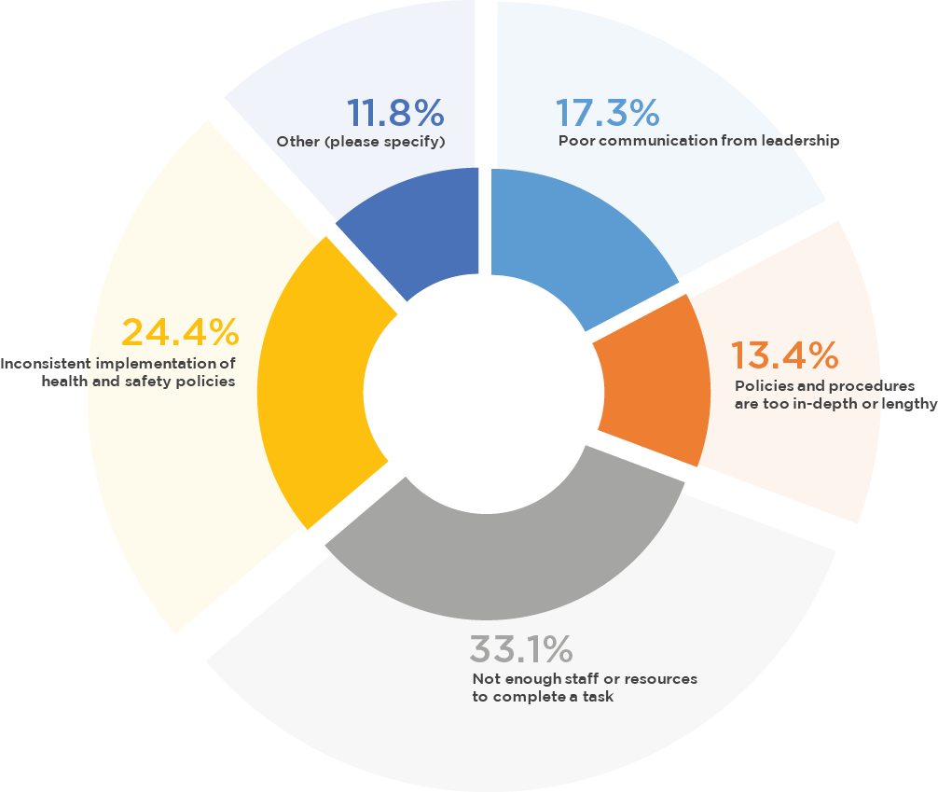
PAIN POINTS
3
What is the most frequent complaint that you hear from employees about your organization's EH&S program?
TOP
33.1%
Not enough staff or resources to complete a task
Inconsistent implementation of health and safety policies
Poor communication from leadership
24.4%
17.3%

Slide 11
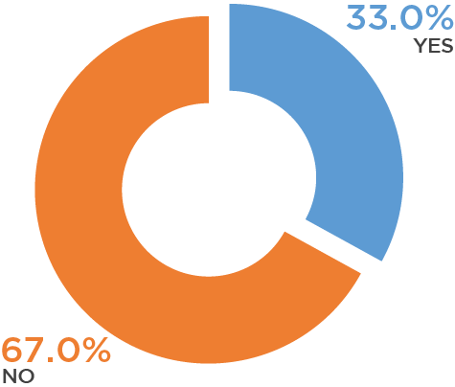
GROWING EHS DEPARTMENT
Are you looking to increase the size of your environmental, health and safety team in the next 12 months?

Slide 12
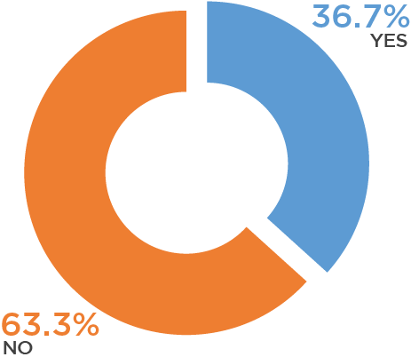
HIRING CONSULTANTS
Does your company currently work with, or have plans to hire, a third-party safety, health and environmental consultant in the next 12 months?

Slide 13
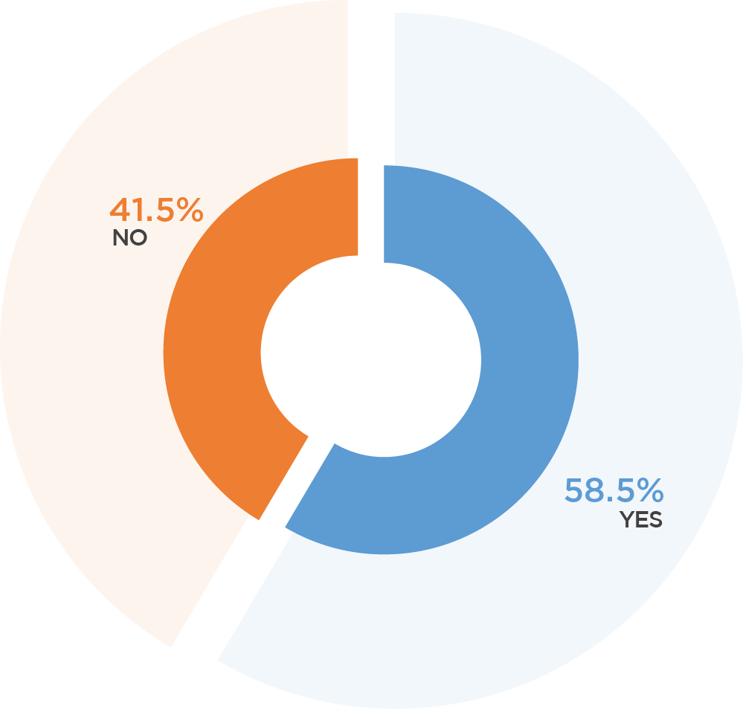
EHS SOFTWARE
Does your company currently use an EH&S software system?

Slide 14
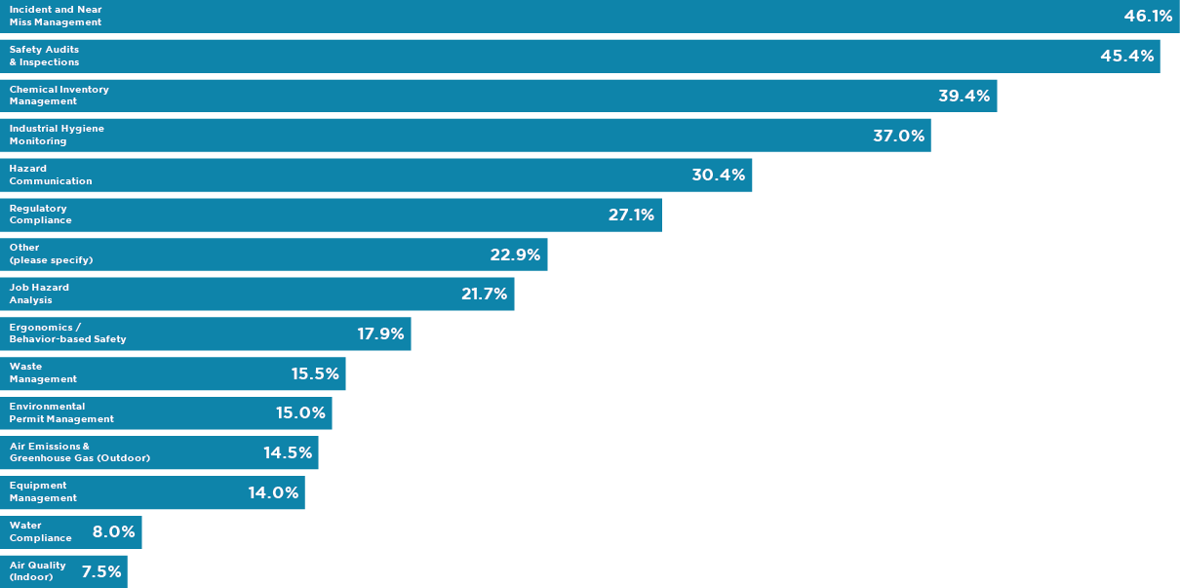
EHS SOFTWARE
3
TOP
46.1%
Incident and Near Miss Management
Safety Audits
& Inspections
Chemical Inventory Management
45.4%
39.4%

